Slide 1
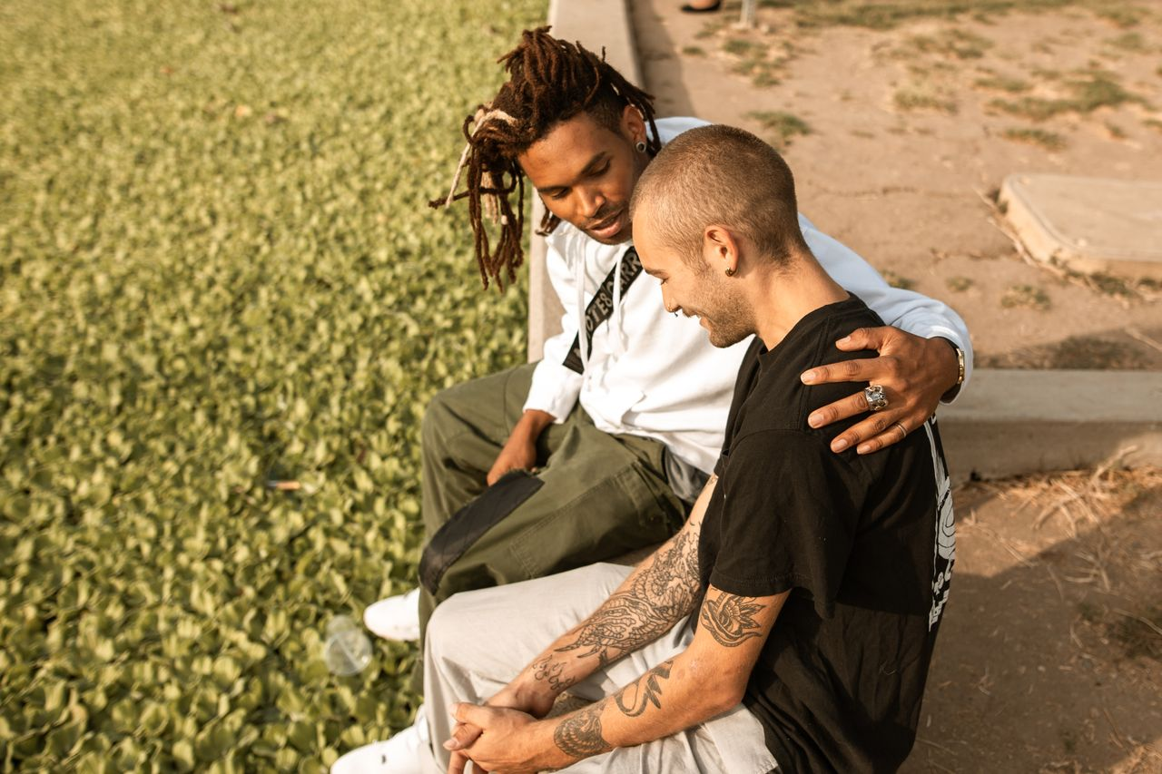
Mental
Health Matters
Grades 7–9
Together For Health

Slide 2
1 in 5
Canadians experiences a mental health problem each year (CAMH)
That includes many people your age. More common than most people think.
Together For Health

Slide 3

🌱
What Affects Your Mental Health?
Big life changes: moving, loss, family stress
Sleep, food, and how much you move
Social media and constantly comparing yourself to others
Pressure at school or from family
Genetics — it can run in families, just like height
Together For Health

Slide 4
👀
Signs a Friend Might Need Support
Pulling away from friends and activities they used to love
Sleeping way too much or not at all
Big, sudden changes in mood or personality
Saying they feel hopeless or like nothing matters
Together For Health

Slide 5

🧰
5 Ways to Protect Your Mental Health
Move your body for at least 30 min a day
1
Sleep 8–10 hours every night
2
Limit social media to under 2 hours a day
3
Stay connected — call a friend, not just text
4
Ask for help before things get really bad
5
Together For Health

Slide 6
💬
Most Important Thing to Know
You would not ignore a broken leg. Do not ignore your mental health either.
Struggling is not weakness. Asking for help is the strong move.
Together For Health

Slide 7
KEY TAKEAWAYS
Mental health is just as real as physical health
✓
Small daily habits make a massive difference
✓
You always deserve support — no matter what
✓
Resources
Kids Help Phone: 1-800-668-6868
Text HOME to 686868
crisis-services-canada.ca
Together For Health

